Slide 1
Haor Flood Management and Livelihood Improvement Project (BWDB Part) Recent Progress Report
Presented By
A.K.M Shamsul Alam,
Project Director

Slide 2
Contents of The Presentation
Flood Situation in the project area(Damage)
Revised design/Design of the pilot embankment construction and plan for implementation of pilot construction.
Activity plan for civil works next two dry seasons
Status of Agriculture component and plan for next FY
Discussion on civil works monitoring format

Slide 3
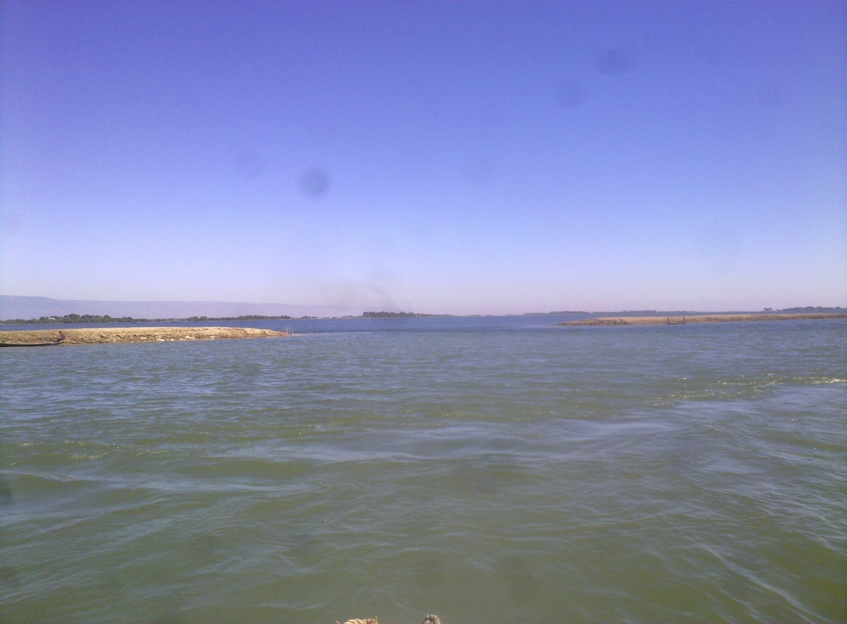
Eroding EMBANKMENT DUE TO WAVE ACTION

Slide 4
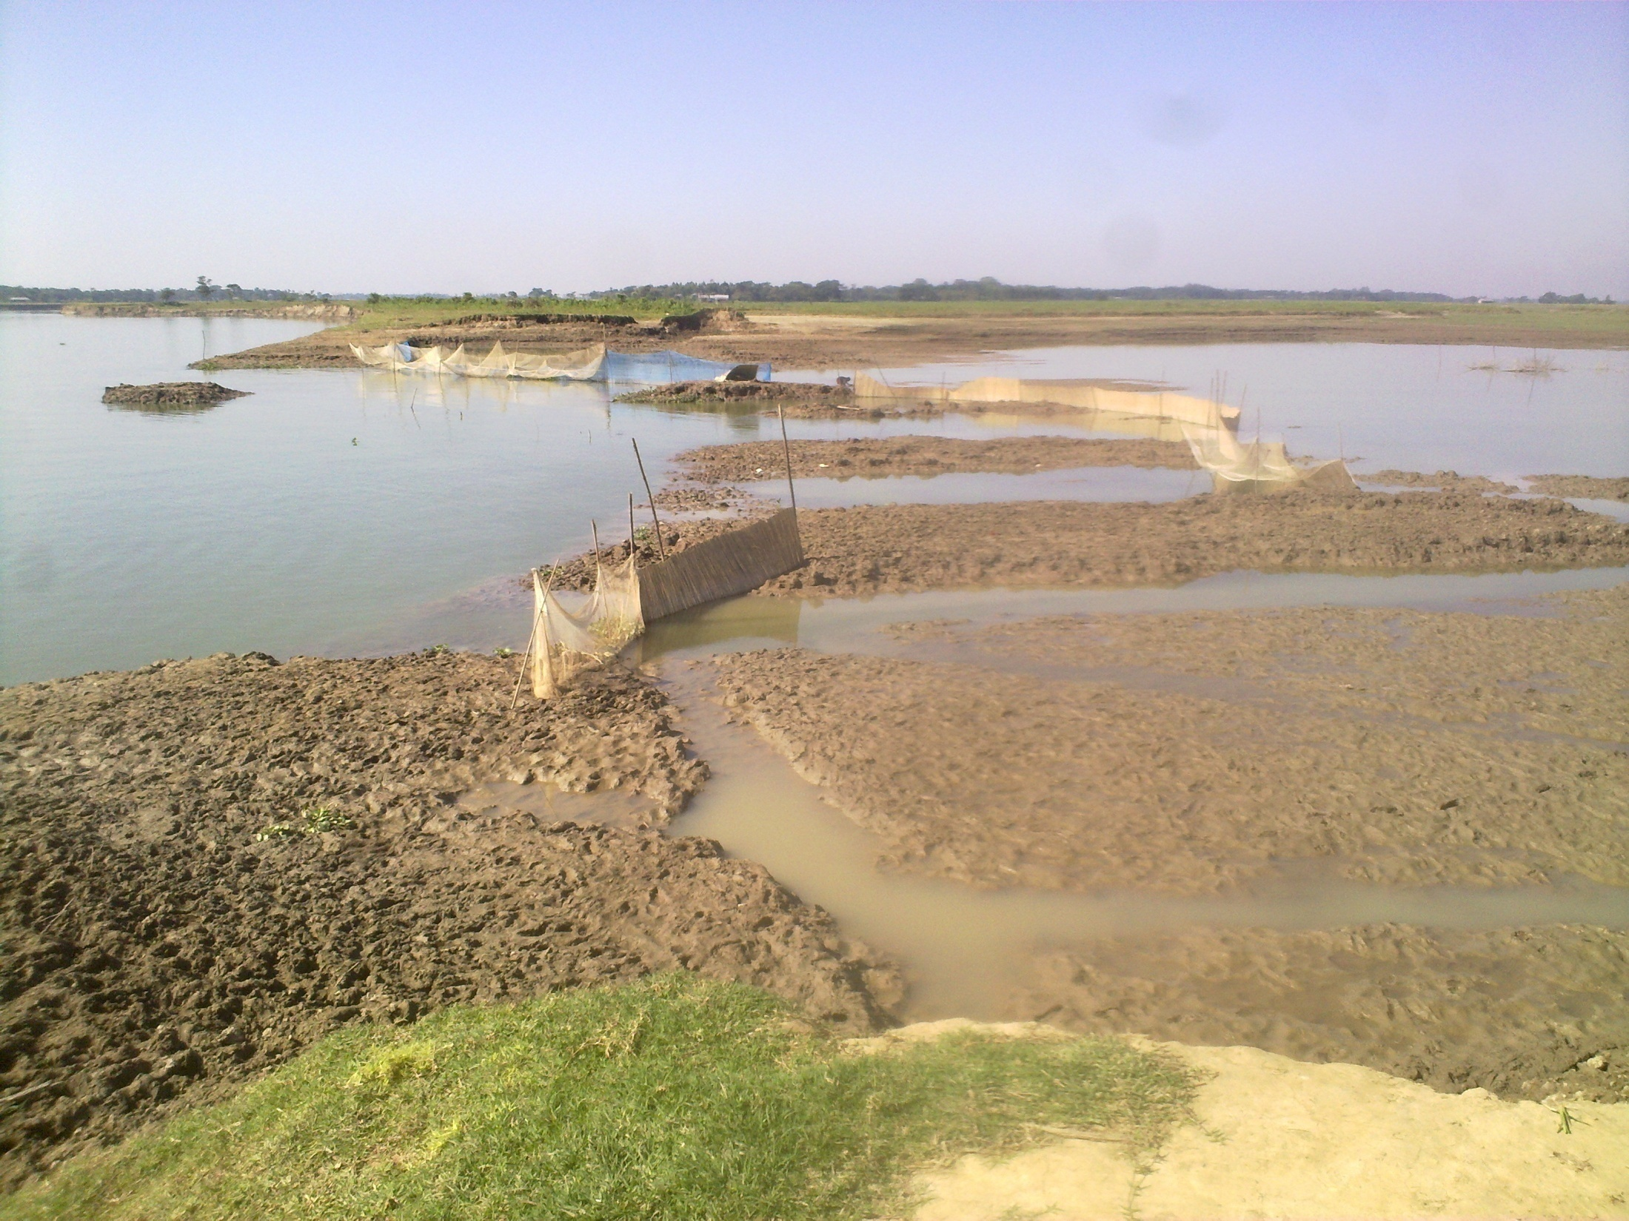
EMBANKMENT DURING FLOOD RECESSION

Slide 5
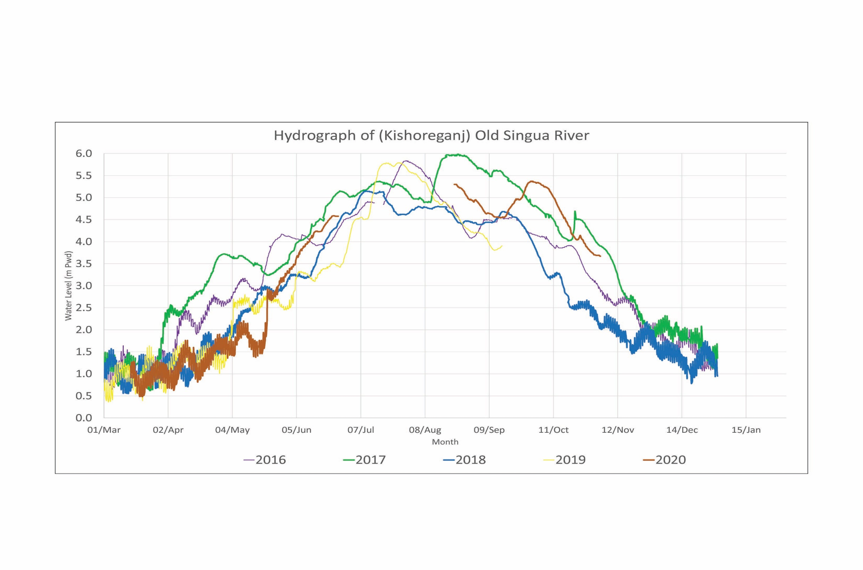

Slide 6
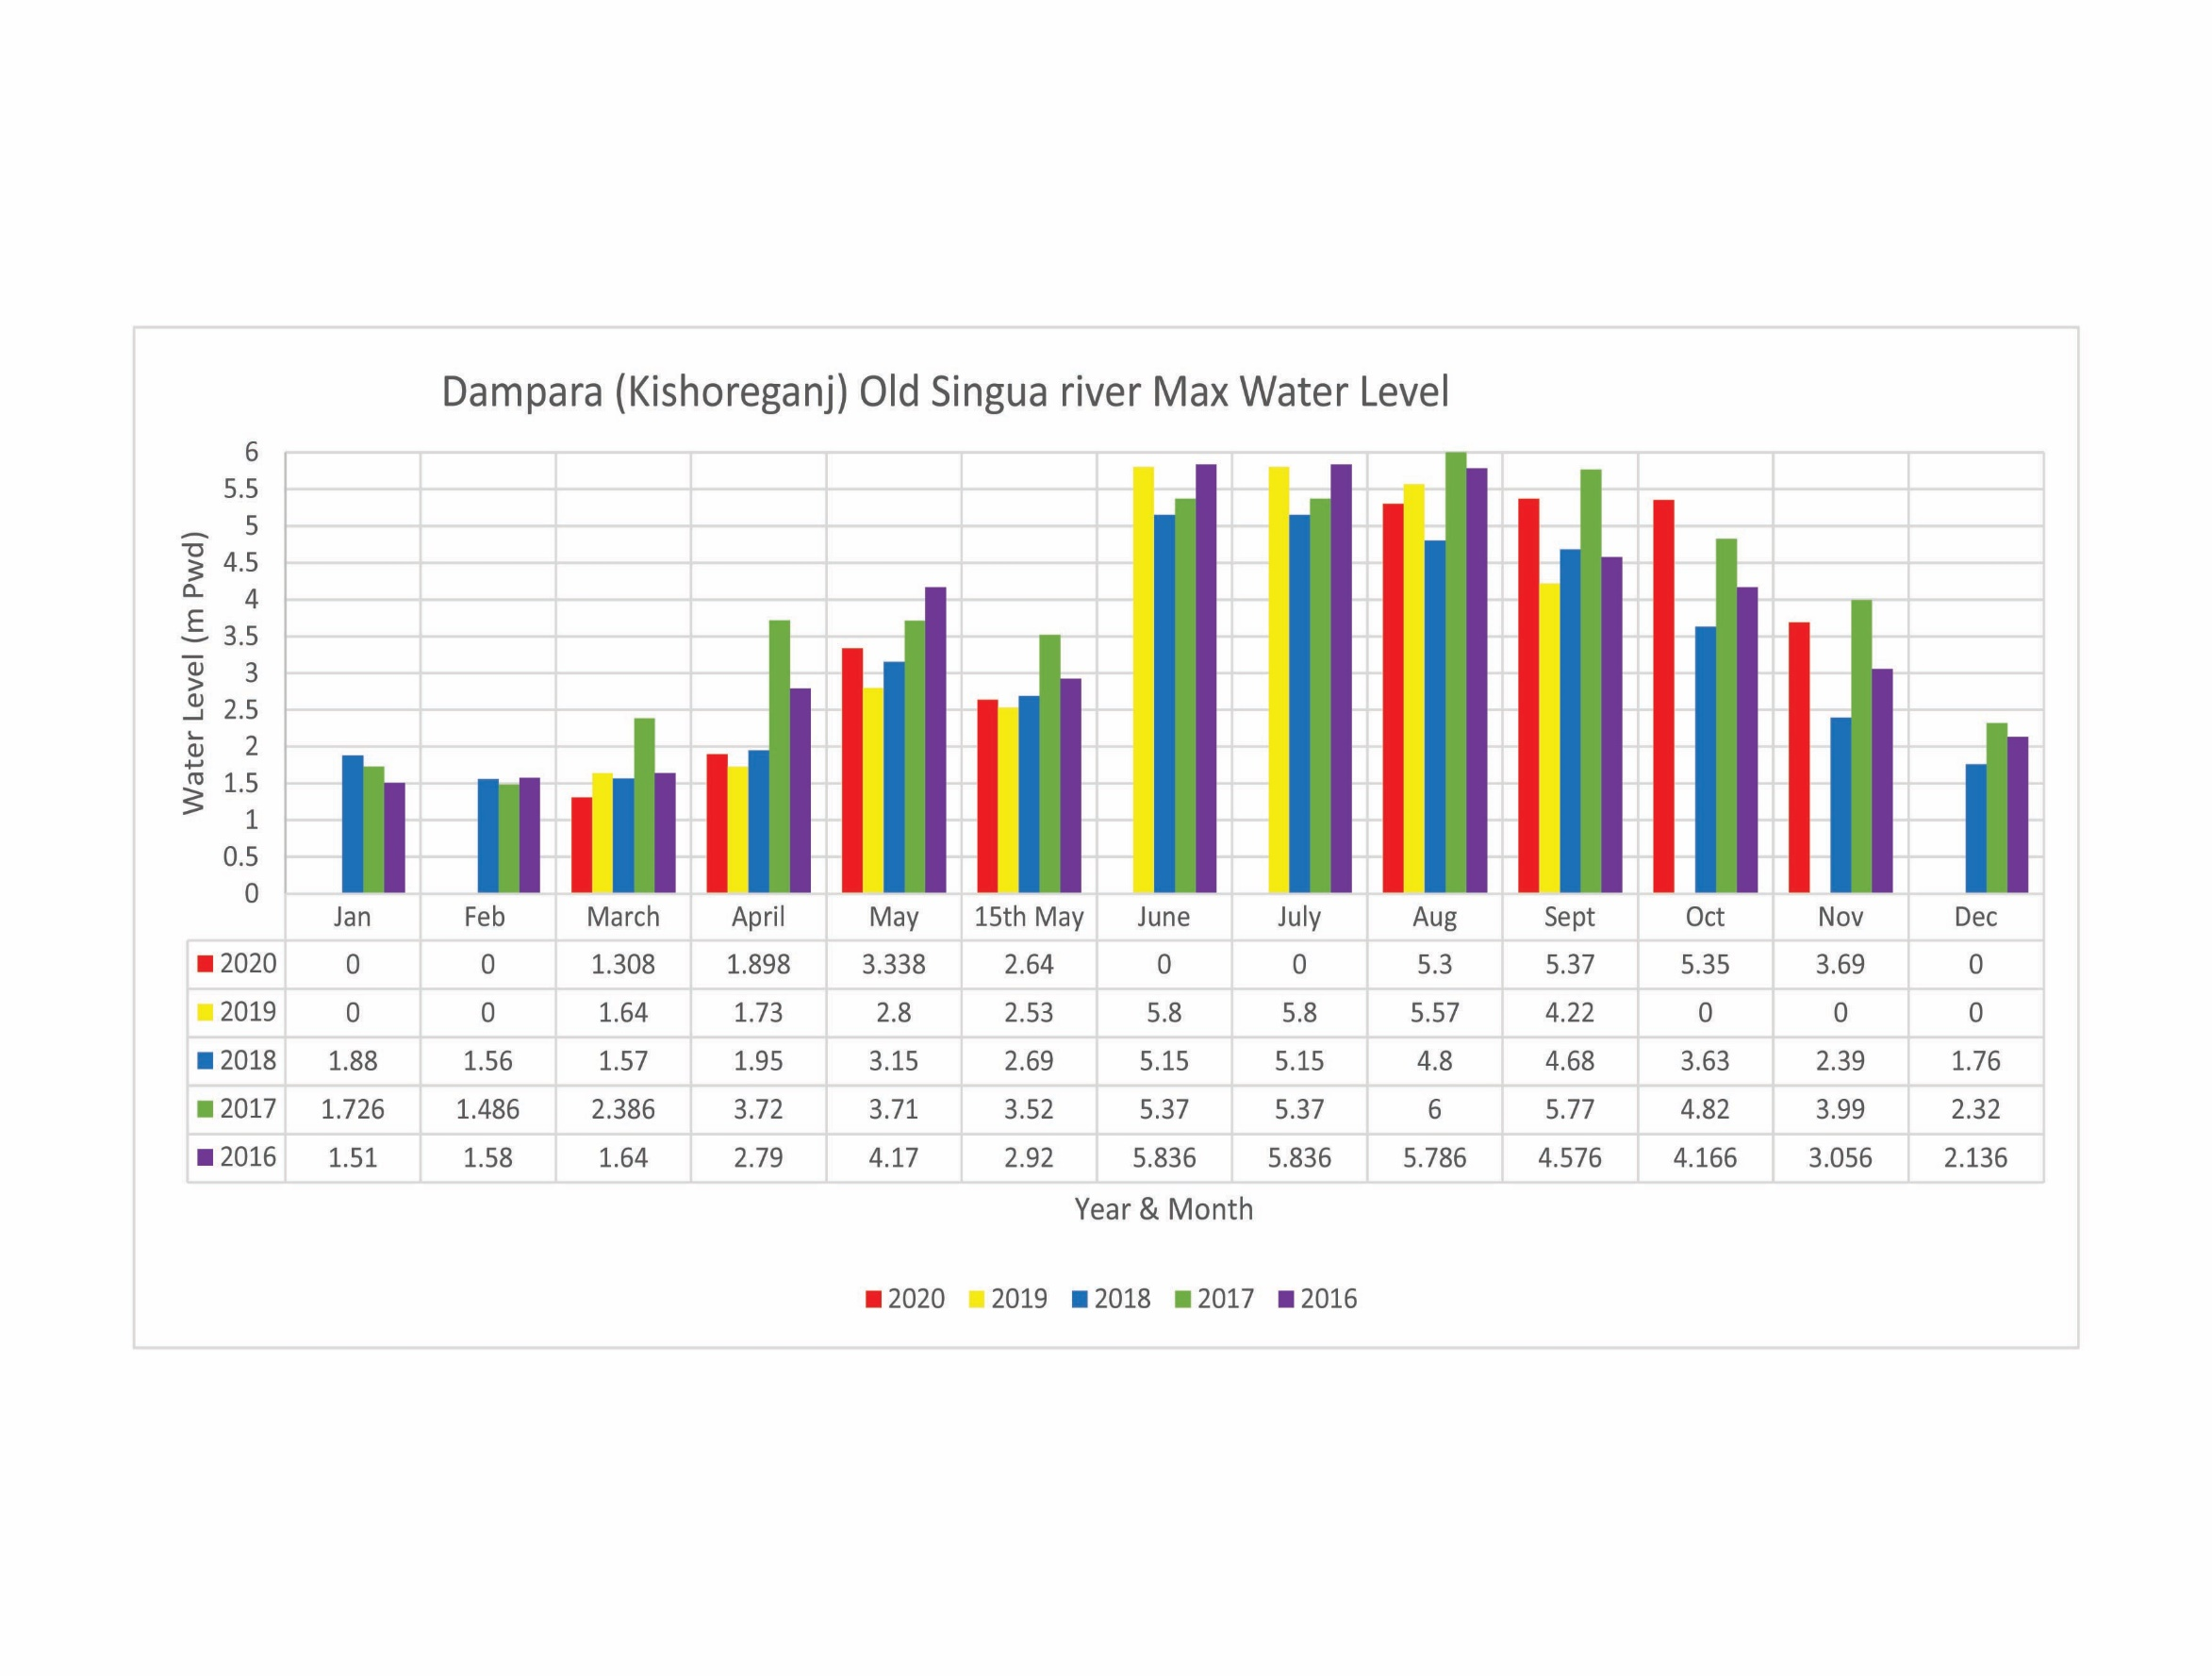
Avg. Crest level of S/E 4.50 m-PWD
Max WL at 15th May 3.52 m-PWD
Average GL 2.10 m-PWD

Slide 9
Avg. Crest level of S/E 6.57 m-PWD
Max WL at 15th May 5.00 m-PWD
Average GL 4.50 m-PWD

Slide 11
2. Revised design/Design of the pilot embankment construction and plan for implementation of pilot construction.
2.1 Type A Protection Work
2.2 Type B5 Protection Work
2.3 Flood Fuse

Slide 12
Protection Type (Type A)

Slide 13
Protection Type (Type B5)

Slide 14
Flood Fuse

Slide 15
Flood Fuse

Slide 16
Flood Fuse

Slide 17
1.Activity Plan for civil works next two dry season
1.1 Physical Achievement up to October 2020
1.2 Current Activities of Component 3-1
1.3 Current Concerns

Slide 18
1.1 Physical Achievement up to February 2020
Physical Progress = 63 %

Slide 19
Tender Status as per 2nd RDPP of HFMLIP
Sl. No. | Tender Status as per 2nd RDPP | Remarks
1 | 47 Packages already Tender and work is on going.
2 | Remaining 9 Packages are to be tendered the F/Y (2020-21) works: 1 No. Submersible Embankment Protection for Dharmapasha Rui Beel at Sunamgonj. 6 Nos. Submersible Embankment Protection for Naogaon, Nunnir, Noapara, Dakshiner Haor at Kishoregonj. 1 no. Threshing floor. 1 no. Gate Replacement for Satdona & Chahal Beel Sub-Project.
Total 55 Nos. and 1 no. O&M during construction.

Slide 21
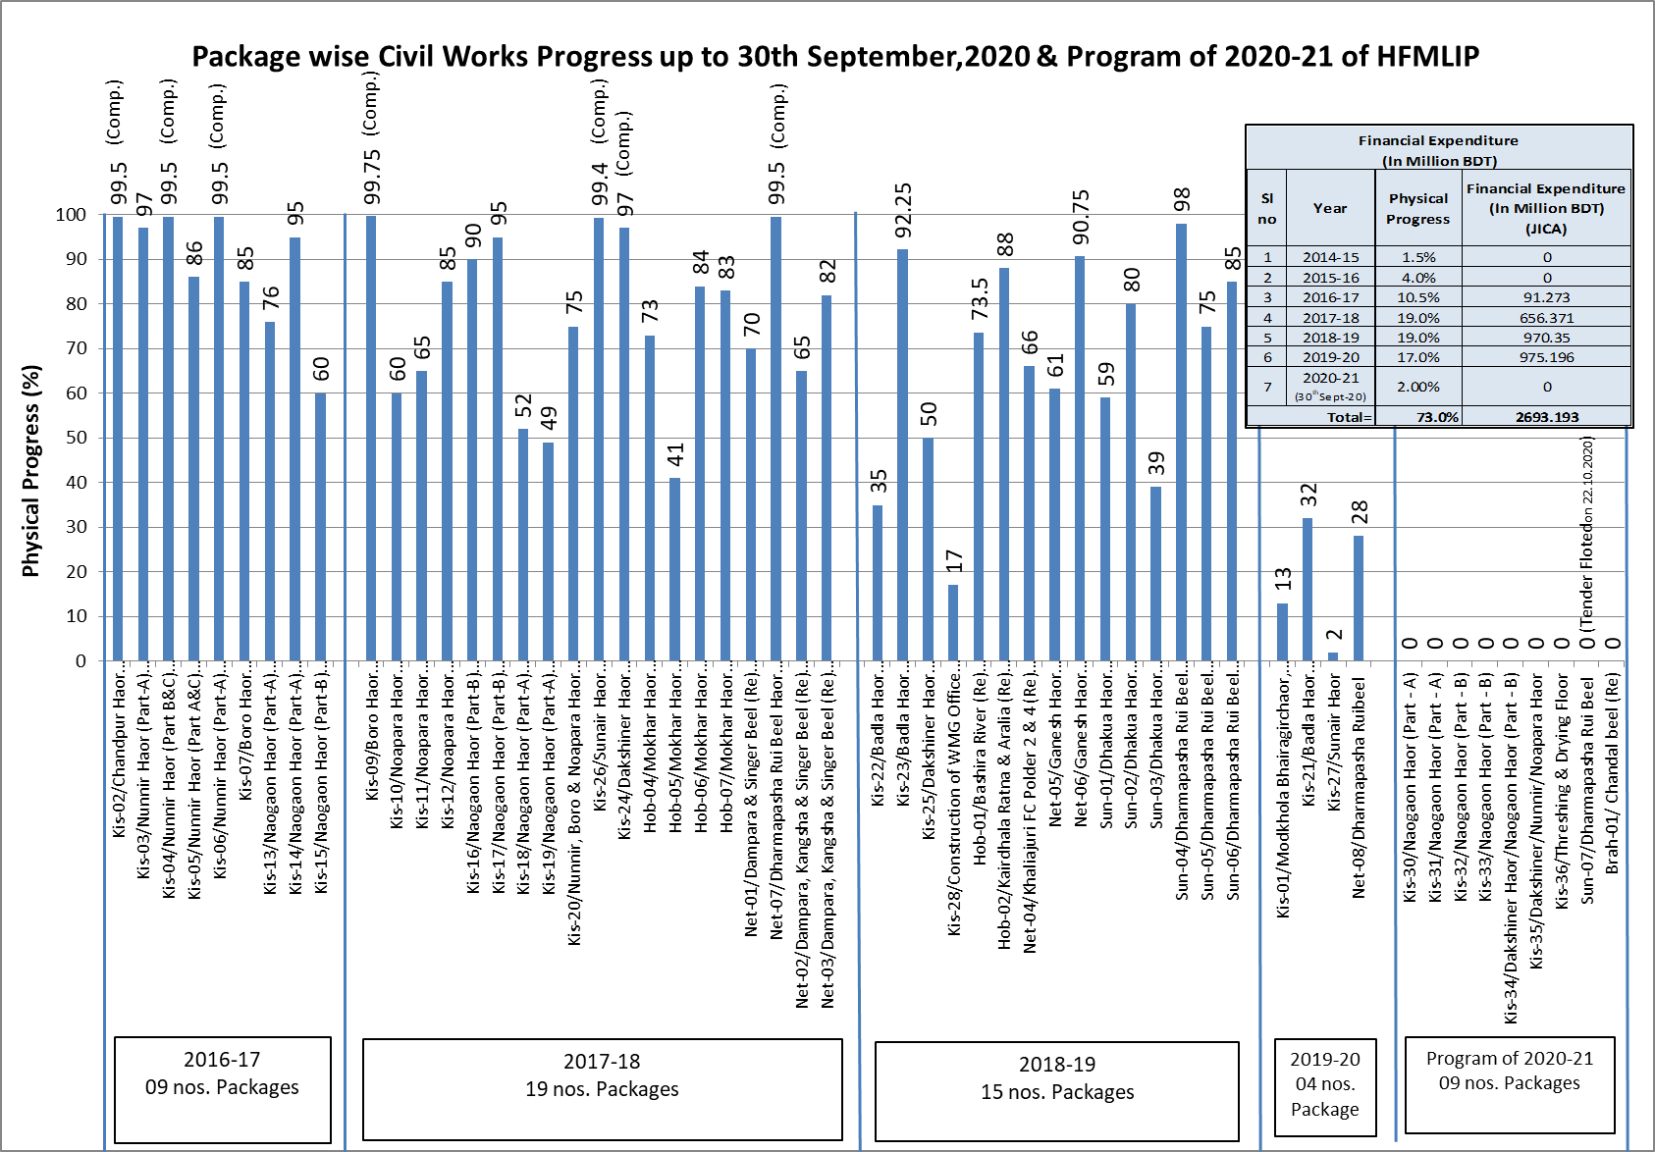

Slide 22
Financial Expenditure (In Million BDT)
Sl no | Financial Year | Physical Progress | GOB | Project Aid (PA) |  |  |  | Total | Cumulative expenditure (in Million BDT)
 |  |  |  | RPA |  | Total RPA | DPA For Consultant
 |  |  |  | Civil Works | Livelihood
1 | 2 | 3 | 4 | 5 | 6 | 7 | 8 | 4+5+6+7
1 | 2014-15 | 1.5% | 60.662 | 0.0000 | 0.00 | 0.00 | 84.96 | 145.6 | 145.6
2 | 2015-16 | 4.0% | 82.428 | 0.0000 | 0.92 | 0.92 | 184.94 | 268.3 | 413.9
3 | 2016-17 | 10.5% | 555.849 | 91.2730 | 34.91 | 126.18 | 109.32 | 791.3 | 1205.3
4 | 2017-18 | 19.0% | 782.197 | 656.3710 | 78.98 | 735.35 | 68.93 | 1586.5 | 2791.7
5 | 2018-19 | 19.0% | 631.334 | 970.3530 | 93.99 | 1064.35 | 68.64 | 1764.3 | 4556.1
6 | 2019-20 | 17.0% | 312.082 | 975.1960 | 39.82 | 1015.01 | 45.00 | 1372.1 | 5928.2
7 | 2020-21 (30thSept-20) | 2.0% | 9.948 | 0.0000 | 0.00 | 0.00 | 0.00 | 9.948 | 5938.1
Total |  | 73.0% | 2434.5 | 2693.2 | 248.6 | 2941.8 | 561.8 | 5938.1

Slide 23
1.2 Current Status of Component 3-1
 | Scope | Major Activities | Target in DPP (2nd rev) | Achievement up to Feb 2020
A | WMO | - Committee Formation | 373 | 299
B | Local Training | - BWDB officials, Field staff, WMG members. | 11,700 WMG Members | 9,400 WMG Member
C | Agriculture Promotion Support Sub-Project (APSS) | - Farmer Training Program, - Demonstrations of crops, rice. - Farmer School Establishment | 69,983 Members | 42,482 Members
D | Small Scale Income Generation Sub-Project (SIGS) | - Homestead Vegetable - Cultivation and Support Service, etc | 26,867 Members | 15,264 Members
 |  | Total | 108,550 Members | 67,146 Members
Note: The International Expert, Mr Matsumoto will be mobilized later March.

Slide 24
4. Status of Agriculture component and plan for next FY

Slide 25
Allocation & Achievement
Upto 30 September, 2020

Slide 26
Upto 30 September, 2020

Slide 27
Upto 30 September, 2020

Slide 28
Upto 30 September, 2020

Slide 29
*Deposition progress downed in 2019-20 due to Pandemic COVID-19
Upto 30 September, 2020

Slide 30
Upto 30 September, 2020

Slide 31
Upto 30 September, 2020

Slide 32
Upto 30 September, 2020
Output: i) 18,16,892 Nos Egg from 1,19,960 Nos distributed duck
ii) 952 Nos kids from 3,858 Nos distributed Goat

Slide 33
Upto 30 September, 2020
Name of demonstration item

Slide 34
Upto 30 September, 2020

Slide 35
Upto 30 September, 2020

Slide 36
Upto 30 September, 2020

Slide 37
Proposed Budget for 2nd Revised DPP and Achievement Upto June'2020

Slide 40
1.3 Current Concerns
Slow Land Acquisition
Approval of the 2nd revised DPP including Protection Work
Approval of Consultancy Service Variation 1

Slide 41
2. Status of Protection Work
2.1 Procurement Status
GoB approval is expected to be granted in April,2020.
Tender announcement at the end of April.
Contractor will be chosen by the end of June.
→ The work will be undertaken in the next dry season.

Slide 42
2. Status of Protection Work
2.2 Repair Work
Repair work of the damaged submersible embankment is in progress for the up coming pre-monsoon season.
Type B5 protection will be applied at Ch 1.5 km, Dhamparasha Rui Beel for trial.
Type B5: Embankment body is covered by geotextile which is overlaid by turfing.

Slide 43
3. Site Visit on March 8-9, 2020
3.1 Itinerary, Participants
3.2 Findings
3.3 Follow Up

Slide 44
3.1 Itinerary, Participants
Participants:
Mr Maeda, JICA Advisor to BWDB Mr Fakhrul Abedin, Co-TL2, Consultant
Mr Saleheen, JICA Project Officer Dr Iryo, Soil Engineer, Consultant
Mr Shamsul Alam, PD, BWDB Other BWDB and Consultant Site Staff
Mr Md. Asaduzzaman, DPD, BWDB

Slide 45
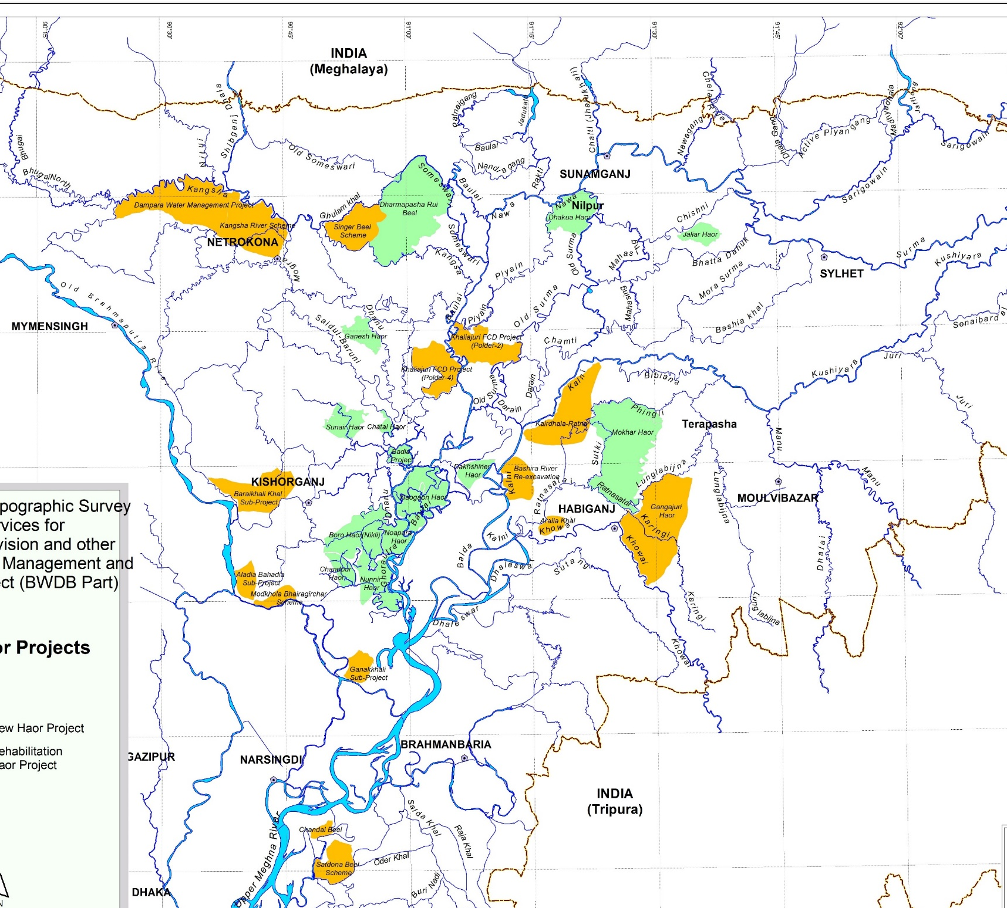
3.1 Itinerary
Dharmapasha Rui Beel
Ch0.5, 1.5 km
Sylhet

Slide 46
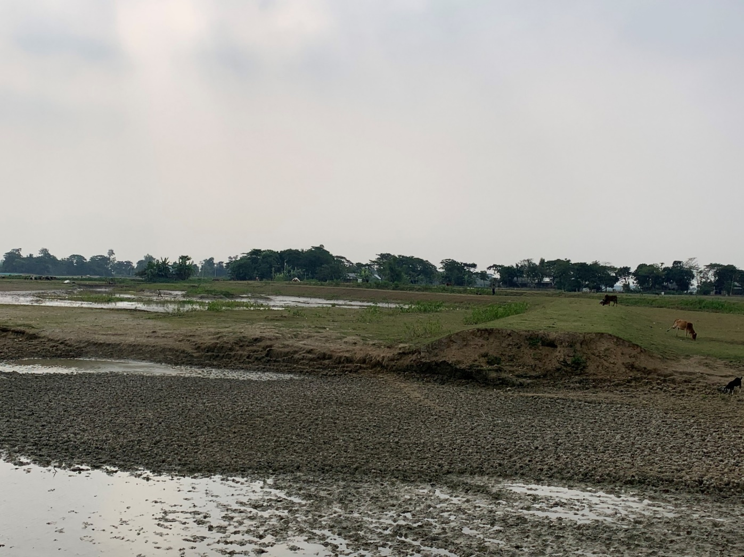
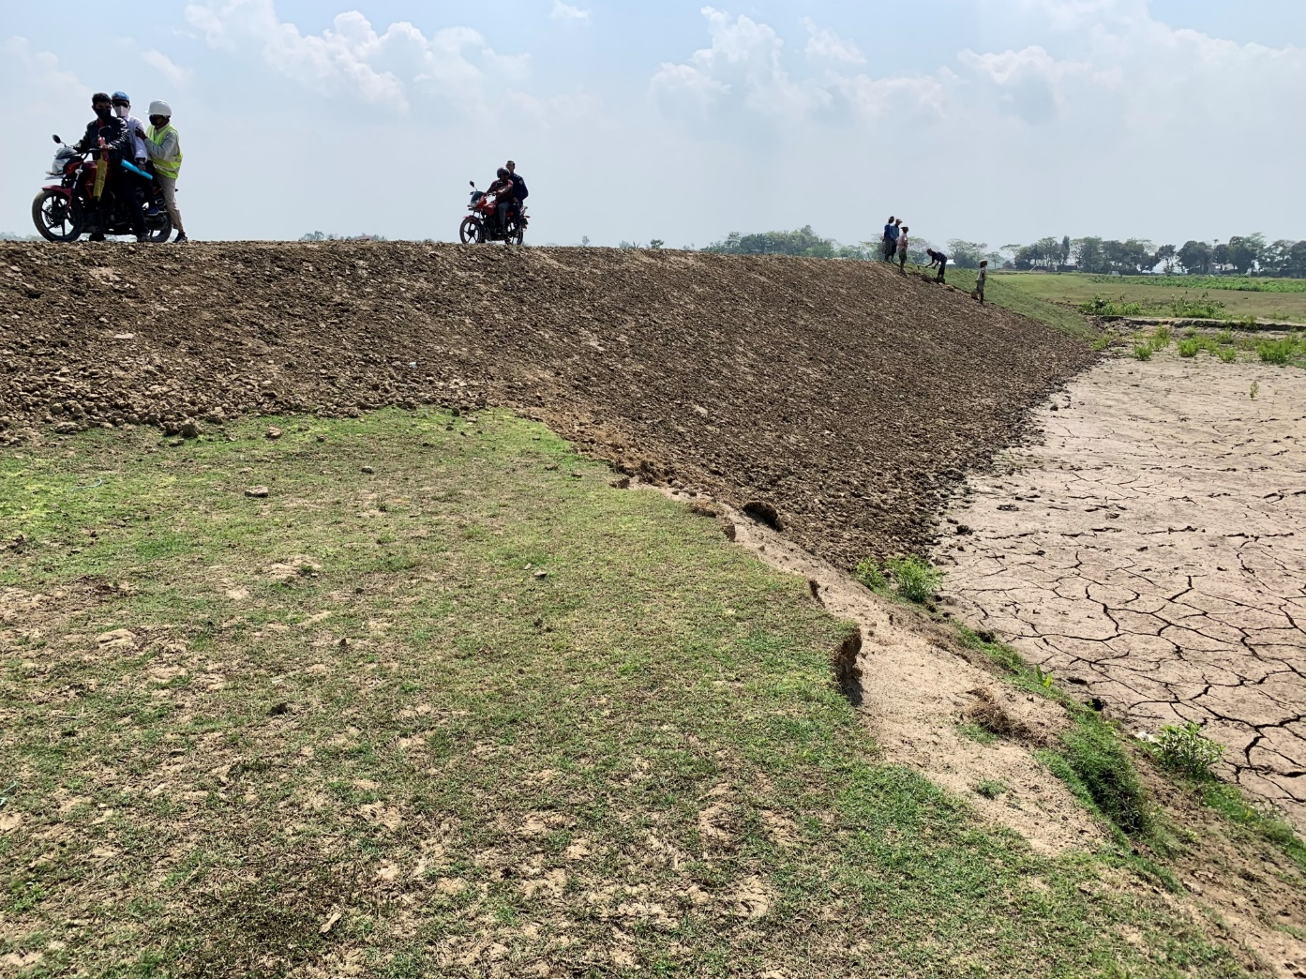
3.2 Findings (Ch 0.5km)
Dec 11, 2019
March 9, 2020

Slide 47
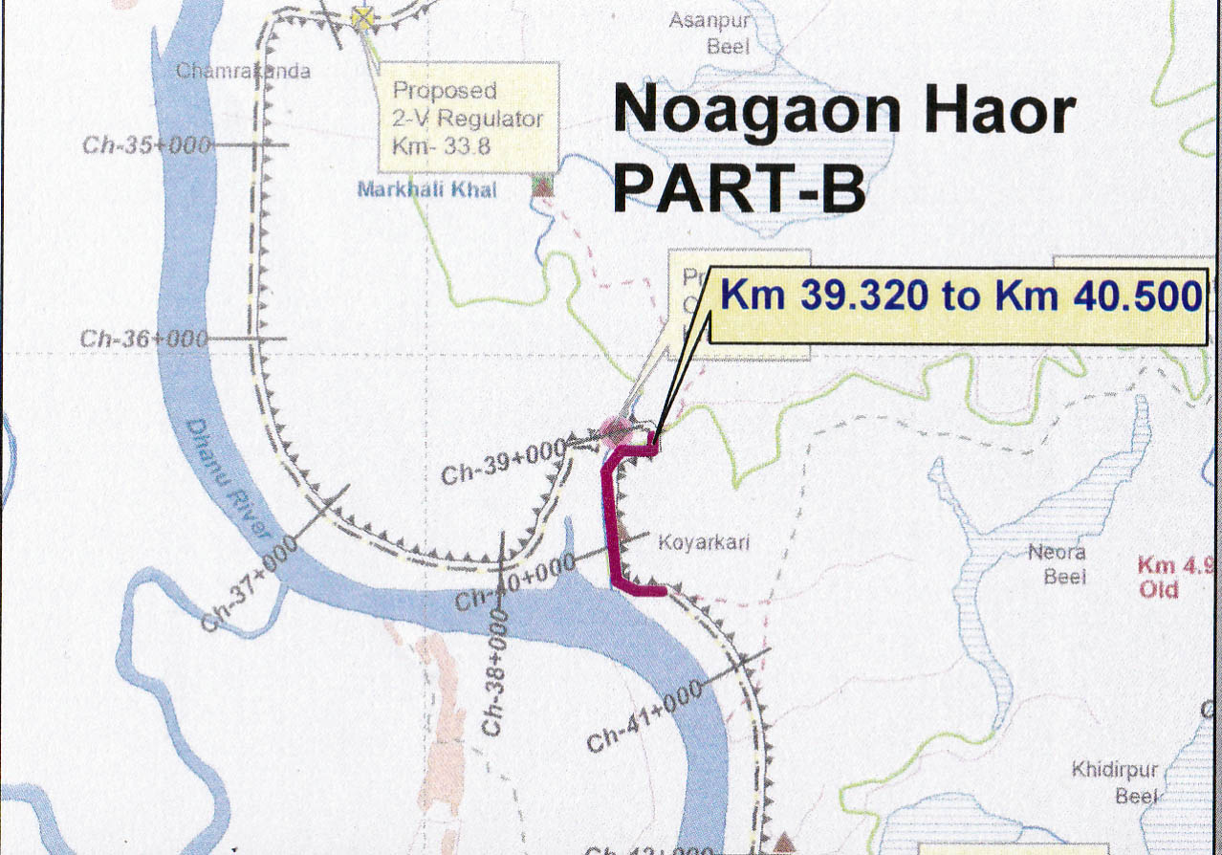
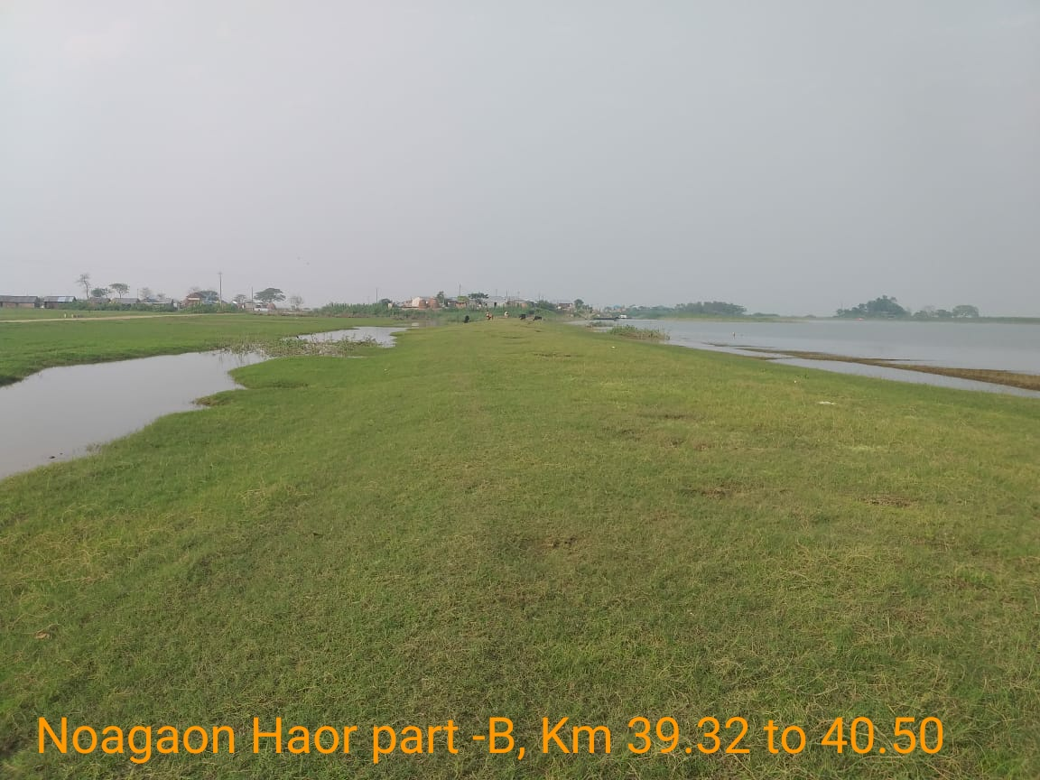
3.2 Findings (Noagaon Haor Part-B 39.32 to 40.50)
05-11-2020
Dec 11, 2019
March 9, 2020

Slide 48
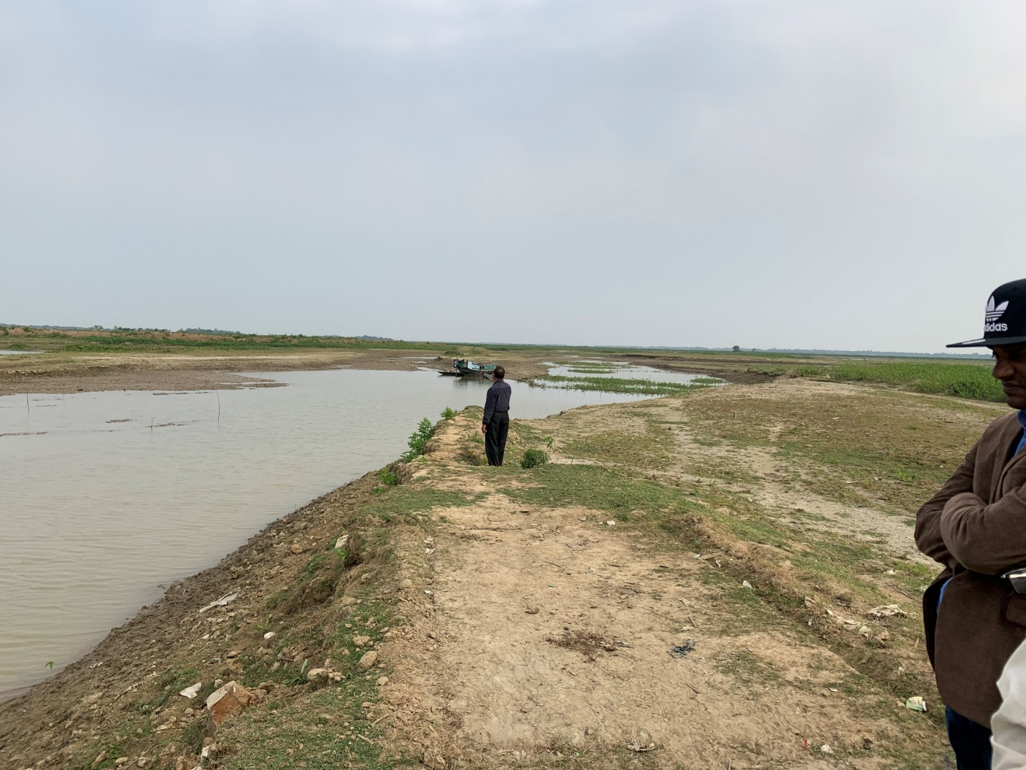
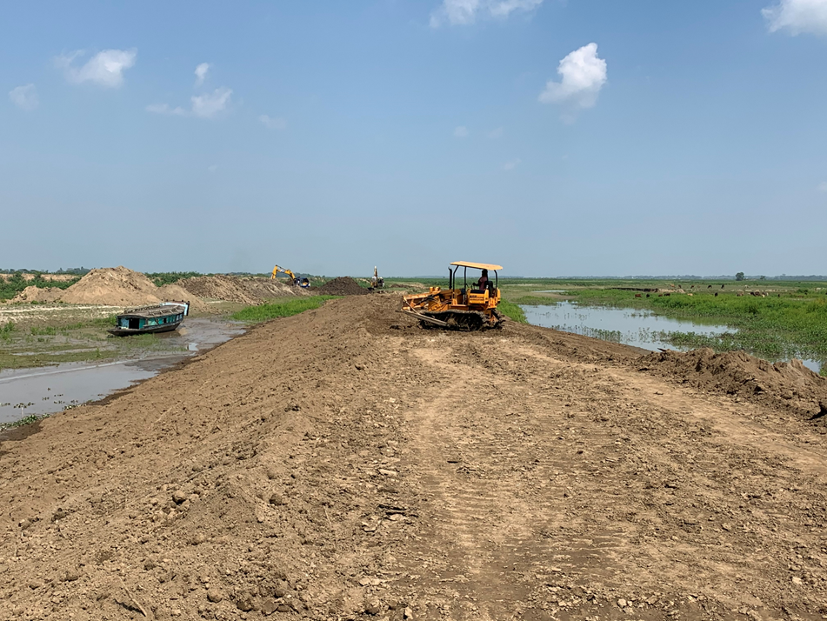
3.2 Findings (Ch1.5km)
Dec 11, 2019
March 9, 2020

Slide 49
3.2 Findings
Repair work of submersible embankments is underway both at Ch 0.5 km and 1.5 km for upcoming pre-monsoon season.
Geotextile is already on site for applying Type B5 at 1.5km.
Compaction was undertaken using chain dozer.
Several compaction tests are to be undertaken.

Slide 50
3.3 Follow Up
Mobilize roller compactor to carry out further compaction.
Compaction test to be carried out at 2 locations at each of Ch 0.5km and 1.5km, depth at 0.5m and 1.5 m, making trench.
Review and improve site inspection system/procedure -> next section.

Slide 51
4. Improvement of Construction Supervisory Work
Comments of the JICA Advisor in January 2020
“BWDB needs to monitor and confirm the condition of the embankments such as grain size distribution of material of the embankments, compaction of the embankments, how to plant grass on slope of the embankments, because these conditions can affect the function of them to prevent erosion”.

Slide 52
4. Improvement of Construction Supervisory Work
Grain Size Distribution
Sieve analysis to be carried out by BWDB technician on samples recovered from field compaction test and for modified proctor test.
Compile already available grading test results.
Planting Grass
Relevant specification of BWDB was sent to the contractors for reminder.
Site personnel shall keep monitoring.
Compaction
Remind site personnel to undertake compaction test even for repair work with proper machinery.

Slide 53
4. Improvement of Construction Supervisory Work
Chain of Command
Re-establish chain of command on site, focusing on Sr Construction Engineers
Close communication between Sr Engineers and Co-TLs.

Slide 54
5. Status of Consultancy Service
Variation 1 was approved by BWDB and submitted to the Ministry of Water Resource (MoWR) on January 13,2020.
Expected to get approval of GoB by April, 2020.
including approval of Co-TL2 and additional input of Soil Engineer and Safeguard (international experts).

Slide 55
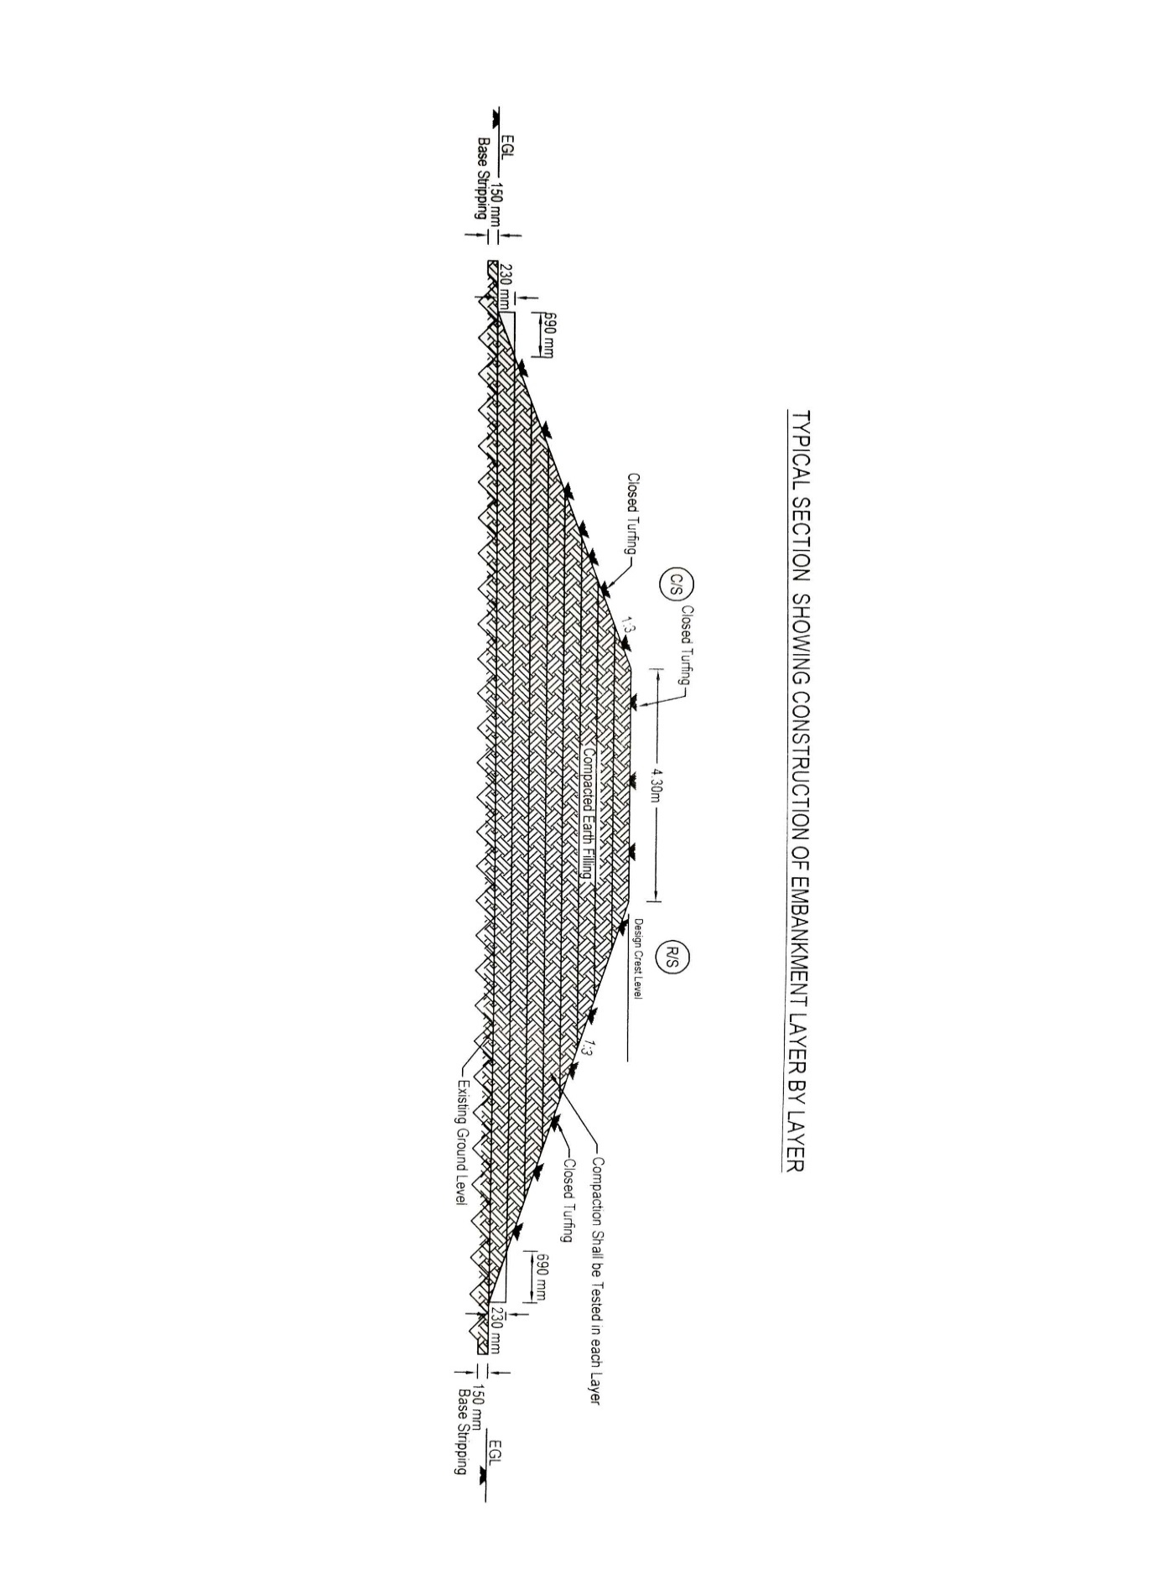

Slide 56
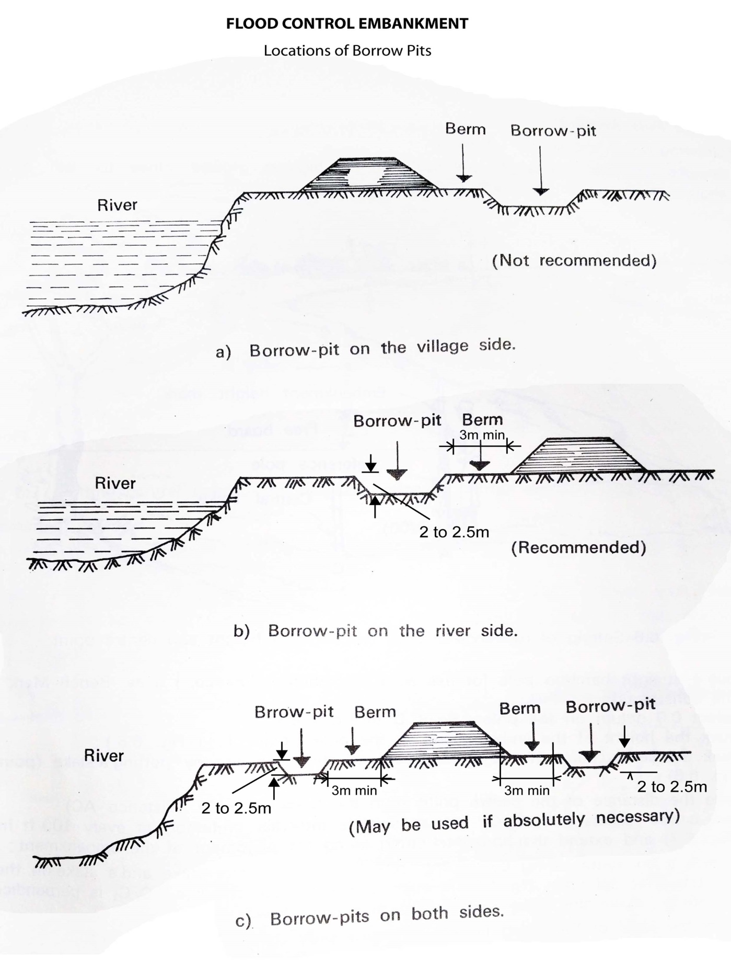
Location of Borrow Pits from The Toe of Embankment
(a) If Earth is Borrowed From The Country Side
20 m

Slide 57
Location of Borrow Pits from The Toe of Embankment
(b) If Earth is Borrowed From The River Side
20m

Slide 58
Location of Borrow Pits from The Toe of Embankment
(c) If Earth is Borrowed From Both Side
20m
20m

Slide 59
Thank you

